Slide 1
The English Ph.D
An overview for Recruitment

Slide 2
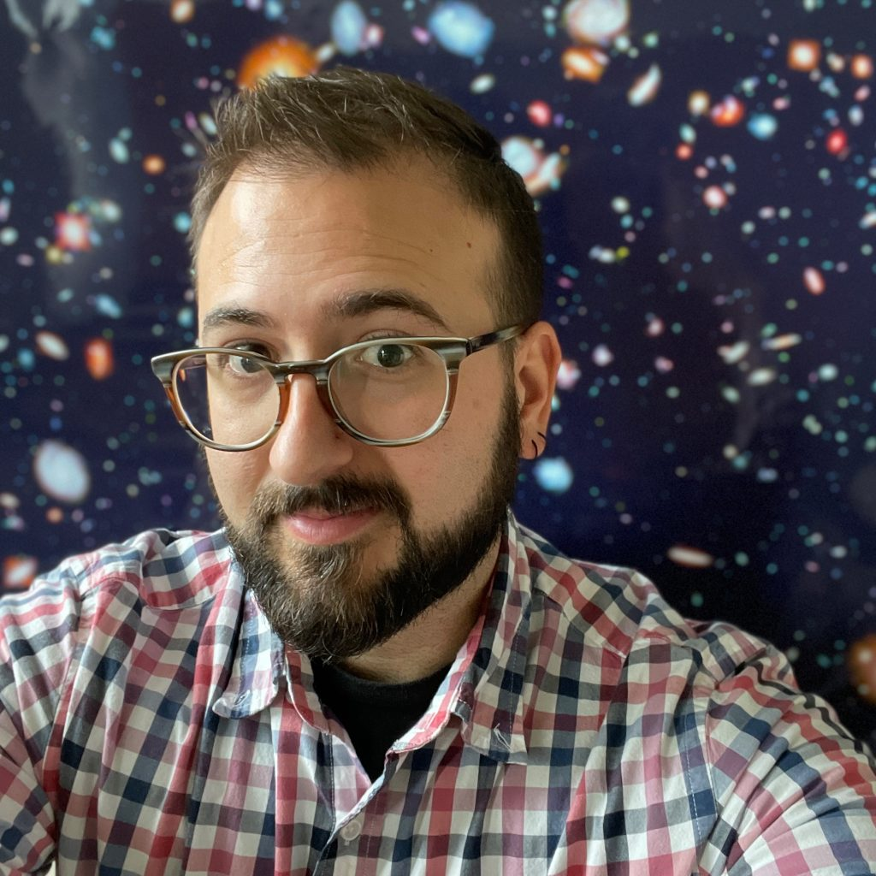
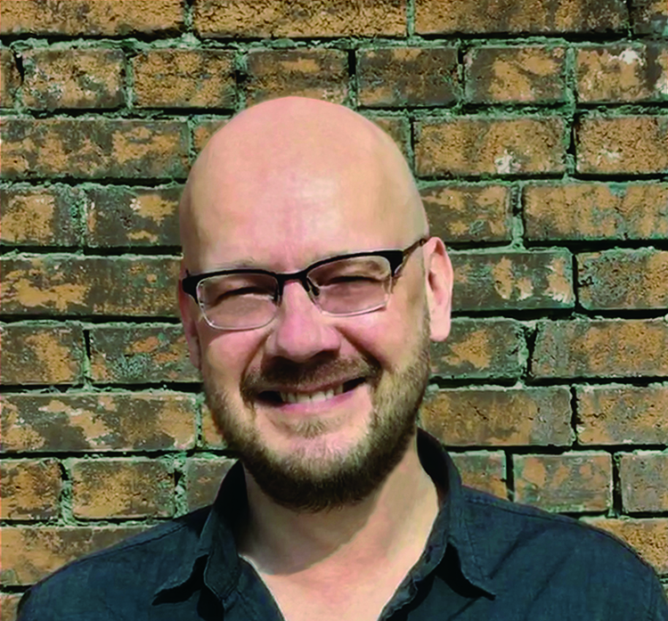
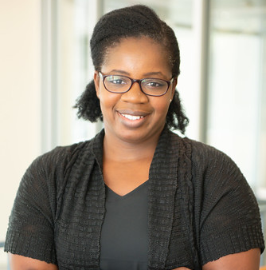
Leadership and Staff
Dr. Josh DiCaglio
Director of
Graduate Studies
jdicaglio@tamu.edu
Dr. Mikko Tuhkanen
Associate Director of
Graduate Studies
mikko.tuhkanen@tamu.edu
Erica Chollett
Graduate Advisor
Erica.chollett@tamu.edu

Slide 3
Timeline for the Ph.D.
5 year completion timeline
Year 1-2: Coursework
Year 3: Preliminary Exams and Prospectus
Year 4-5: Dissertation

Slide 4
Seminars
8-10 seminars are offered per semester
You take 3 per semester
602: First Year Seminar in your first semester
697: Pedagogy, your first semester of teaching unless you have an equivalent
603: Bibliography and Methods in the Spring of year one, unless you have an equivalent
Distribution requirements: 1 pre-1800, 1 post-1800, 1 Theory

Slide 5
Currently Scheduled Seminars for Fall 24 (subject to change)
602 | FY Seminar | J DiCaglio
618 | Readings in 18th British Lit. | Egenolf
655 | Contemporary Rhetoric (Medical) | S. DiCaglio
680 | Gender Theory | Reddy
672 | Early Black Atlantic | Dworkin
610 | Old English | Mize
653 | What was Postmodernism | Robinson
DHUM 601 | Intro to DHUM | Torabi
697 | Pedagogy | Kennedy
695 | Publication and Professionalization | O'Farrell

Slide 6
Currently Scheduled Seminars for Spring 25 (subject to change)
603 | Bibliography | O'Sullivan
650 | R in 20/21st | Tuhkanen
671 | R in Am Lit to 1900 | Earhart
653 | Age and Memory Studies in the Heatlh Humanities | Howell
610 | Beowulf | Mize
698 | T in Digital Pedagogy: OERs | Lemire
656 | Writing Studies after GenAI | Crider
666 | Early Engl Periodicals | Ezell
603 | Bibliography | O'Sullivan
650 | R in 20/21st | Tuhkanen

Slide 7
Assistantships and Support
Fully funded, including tuition, stipend, and health benefits
Currently $20,000 per year for 5 years of study
Includes a 1/1 teaching load
9 months (summer teaching is separate)
Summer teaching is widely available, but number of sections varies from summer to summer.
Teaching 1 course = 1.5 months at stipend rate
Teaching 2 courses = 3 months at stipend rate
Note: this year, nearly all requests for teaching were filled, including those wanting to teach 2

Slide 8
Internal Competitive Fellowship opportunities
English Graduate Fellowship
1 per semester, must have defended prospectus
Course release for 1 semester
Graduate and Professional School Fellowship
Highly competitive
2 semesters fully funded (no teaching)
Glasscock Residential Fellowship
Humanities specific
Course release for 1 semester + $1000 bursary
Other fellowship opportunities arise from year-to-year internally and we can assist you in applying for external grants and fellowships.

Slide 9
Teaching
Training is provided with each new course
International Students typically work as TAs (graders) for their first year
First year of teaching is 104: Freshman Composition
Students then often move on to 210: Technical and Professional Writing
Or 203: Writing about Literature (a more highly customizable course)
All students are given at least one upper division course once they are ABD
Summer teaching is mostly 210 online sections

Slide 10
Professionalization and Placement
Given the realities of the academic job market both in the US and abroad, we acknowledge and work with a wide variety of potential career outcomes while also preparing you for a potential career in academia.
Academic Job Market Preparation
Formal Article writing workshop (every 2 years)
Placement and professionalization course (every 2 years)
Mock interviews, job materials review available from Graduate Office
Regular workshops for professionalization
Wide-ranging teaching experiences and training opportunities
Research and Conference support
Alumni network for Korean applicants
Non-academic Job Market Preparation
Robust Career Center on-campus, providing consultations and career events
Wide-ranging teaching experiences
Professional development experiences and trainings available (e.g. Digital Humanities Summer Institute)
Grant writing support (through College)

Slide 11
Recent Placements
We continue to place students into academic and competitive non-academic jobs. A few recent examples include:
Heoyeol Kim (2022): Machine Learning Data Linguist, Amazon Services
Hyunjung Kim (2021): TT at Pukyoung National University
Elias Adanu (2020): TT at University of Texas, El Paso
Yoojung Choi (2020): TT at Incheon National University
Jeffrey Utzinger (2019): TT at Concordia University, Texas
Caitlin Brenner (2019): Digitalization Library Assistant, Dolph Briscoe Center of American History at UT Austin
Somi Ahn (2019): TT at Pusan National
Nelson Shake (2019): Professor at Savanah College of Art and Design

Slide 12
Research, Travel, and Conferences
Conferences: Generally, we support most students to attend one conference per year, with particular emphasis on major international or national conferences
Research enhancement trips and professional development funds are available, usually once or twice in your time as a graduate student.
Additional research funds are available through the college and other initiatives.

Slide 13
Graduate Certificates
Graduate certificates are an optional way of enhancing your education and interfacing with students and faculty across departments. Certificates of interest:
Digital Humanities
Africana studies
Film and Media studies
Latino/a and Mexican American Studies
Popular culture
Women’s and Gender Studies

Slide 14
Campus Resources and Initiatives
There are a wide array of Centers and Initiatives across the university who can provide community and funding to support your graduate education. Of particular note are:
The Glasscock Center for Humanities Education
Center for Digital Humanities Research (CoDHR)
Race and Ethnic Studies Institute (RESI)
Women and Gender Studies Program
Environmental and Sustainability Studies Program
Center for Teaching Excellence (including Teaching as Research Program; Academy for Future Faculty)
All of these programs offer some level of funding for research in addition to regular programming and events.

Slide 15
Reminder: Decisions are due by April 15th

Slide 16
Questions?

